Slide 1
Real-time Visualization of Mata Garuda Log Analysis Using Log Data Streams & Lambda Architecture for Real-time monitoring
By Dimas Rizky H.P. (2110141011)

Slide 2
Table of Content
Introduction
Background & Fact
Problem
Illustration
Goal
Solution

Slide 3
Introduction
Mata Garuda, snort-based NIDS
Snort-based Mata Garuda is using signature base technique to detect the malicious activity
It still needs 15 minutes to fetch the log and refreshing the graphical log

Slide 4
Background - Fact
The main problem of using signature based technique is it vulnerability to unknown attack
It can be overcome with network administrator self-monitoring activities
To perform optimal self-monitoring, network administrator have to see the event log by him/herself

Slide 5
Background – Problem
Mata Garuda already implemented the graphical log monitoring system
But, it needs some time (15 minutes) to fetch the data from the analytic
The time needed to recognize the threat is should be short enough.

Slide 6
Goal
Create a realtime vizualisation of Mata Garuda Log
Reduce the time-related threat caused by uknown attack by providing the network administrator real-time monitoring capabilities

Slide 7

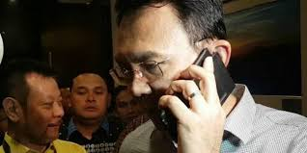


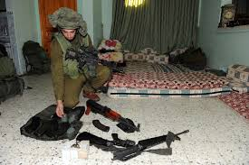
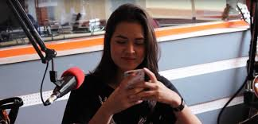

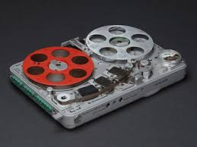

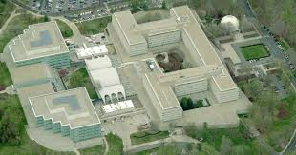





Illustration
Traffic
Snort
Action
Network
Admin
Batch (depend)
Log
Batch
(15min)
Stream (Instant)

Slide 8
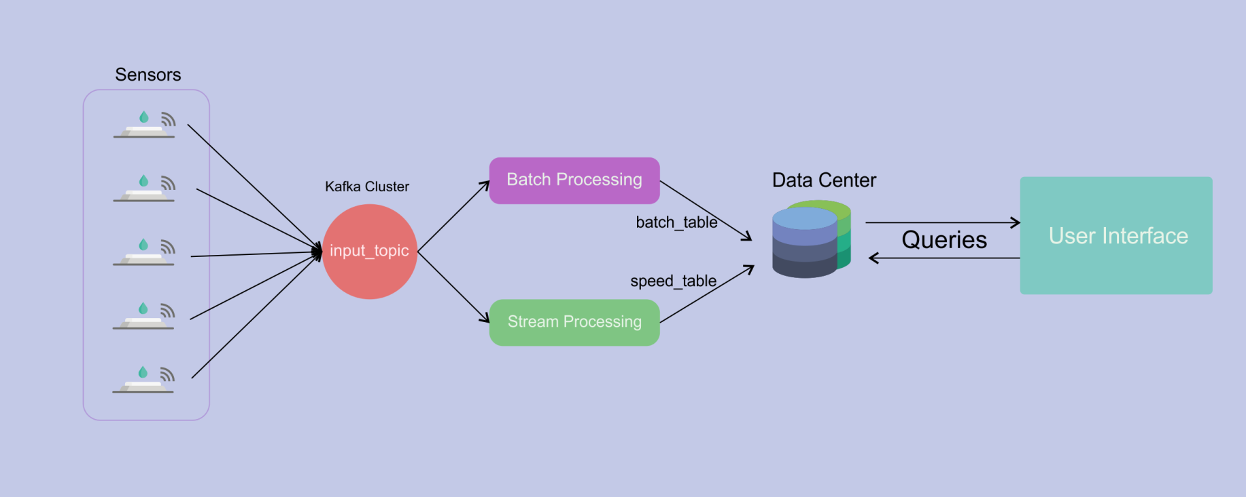
Solution

Slide 9
That’s all
Thank You

